Slide 1

Blood Pressure Wearables Programme
Kickoff meetings
The BIHS Blood Pressure Wearables Programme has been established to develop a practical UK route for evaluating wearable blood pressure technologies, defining safe NHS data pathways, and delivering the first real-world pilot in a clearly bounded clinical use case.
The programme is structured through three linked workstreams which are being progressed in parallel:
Workstream 1
Evaluation framework
Workstream 2
Data pathway
Workstream 3
Real-world pilot
March 2026
Notes:
[Sources]
- Programme purpose, objective, and workstream framing from BIHS Wearable Blood Pressure Programme Framework March 2026. fileciteturn0file0
- Meeting timing and launch context from BP Wearables Team Actions and Next Steps. fileciteturn0file1
[/Sources]

Slide 2
Why this programme
And why now
Wearable BP technologies are advancing faster than current clinical adoption pathways
CE marking alone does not answer NHS trust, pathway fit or clinical confidence
NHS adoption will require more than technical performance: it needs usable outputs, governance, data boundaries and real-world evidence
BIHS is recognised by the NHS, regulators and the public for standard setting and as BP device validation experts.
Therefore, well-placed to convene the right experts to define a clinically credible, proportionate route that supports innovation without lowering standards.

Slide 3
How the programme fits together
Three parallel strands, one route from early evaluation to NHS readiness
1 - Evaluation framework and clinical use
2 - Data pathway and NHS integration
3 - Real-world evaluation pilot
Defines use cases, claims boundaries, evidence thresholds and conditions for staged evaluation.
→
Defines what data should flow, to whom, in what form, and under what governance..
→
Tests the framework and pathway in practice through a defined ABPM-linked pilot.
Combined programme outcome: A UK model for wearable BP evaluation, NHS readiness and scalable future implementation.
Notes:
[Sources]
- Workstream objectives, focus areas, and interdependencies come from the BIHS programme framework. fileciteturn0file0
[/Sources]

Slide 4
Kickoff discussions
Designed to work for each of the three workstream launch sessions
1
Confirm workstream purpose
Outputs to leave with
How this strand contributes to the overall BIHS programme and where it interfaces with the other two workstreams.
• Leads and contributors
• Immediate decisions log
• First deliverables and date
• Cross workstream dependencies
• Next meeting dates
2
Review the architecture
Anchor boundaries: evaluation vs service evaluation vs implementation, practitioner outputs, governance and escalation.
3
Agree immediate priorities
Identify the near-term decisions that must be taken in the next 4-6 weeks.
Define first outputs
Suggested timing
4
60 min total
10 min context
20 min architecture and boundaries
20 min priorities and outputs
10 min actions and close
Agree what the workstream should produce before the next checkpoint and what “good” looks like.
5
Map dependencies and external asks
Confirm cross-workstream dependencies, key partners, and meetings needed next.
Notes:
[Sources]
- Suggested kickoff agenda is adapted from the BIHS programme framework. fileciteturn0file0
- Need to separate validation, diagnostics, data pathway and implementation tasks comes from the meeting discussion. fileciteturn0file1
[/Sources]

Slide 5
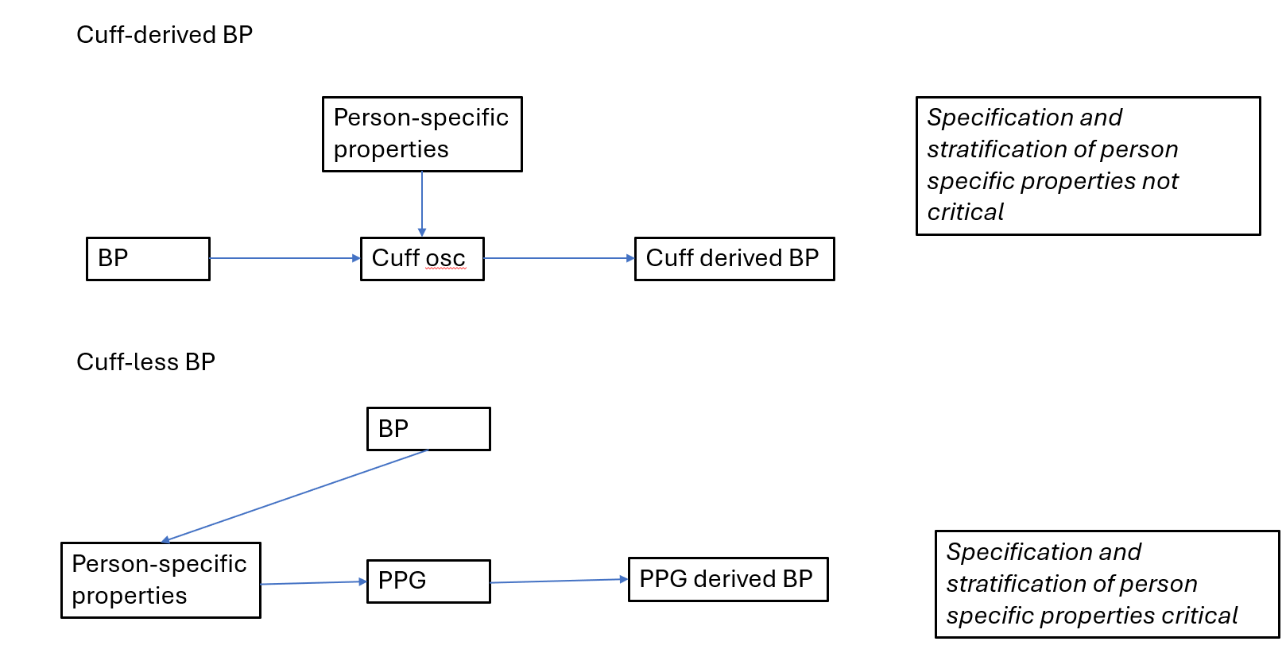
Background: Cuff-less (PPG) vs. cuff-derived BP

Slide 6
Emerging wearable BP validation protocols
Specific individual characteristics that may influence the PPG signal
For example: age, sex, blood pressure range, skin tone and other biological or clinical factors.
Challenges:
Even a very simple 2 strata model for each characteristic, for example BP (normal/high), sex (male/female), age (younger/older), skin tone (lighter/darker) - would require a very large study population: (e.g.) 40 × 2⁴ = 640 participants
Not all relevant factors affecting the relationship between PPG and blood pressure have yet been clearly identified
The relationship between BP and PPG may differ in people with hypertensive target organ damage compared with those without

Slide 7
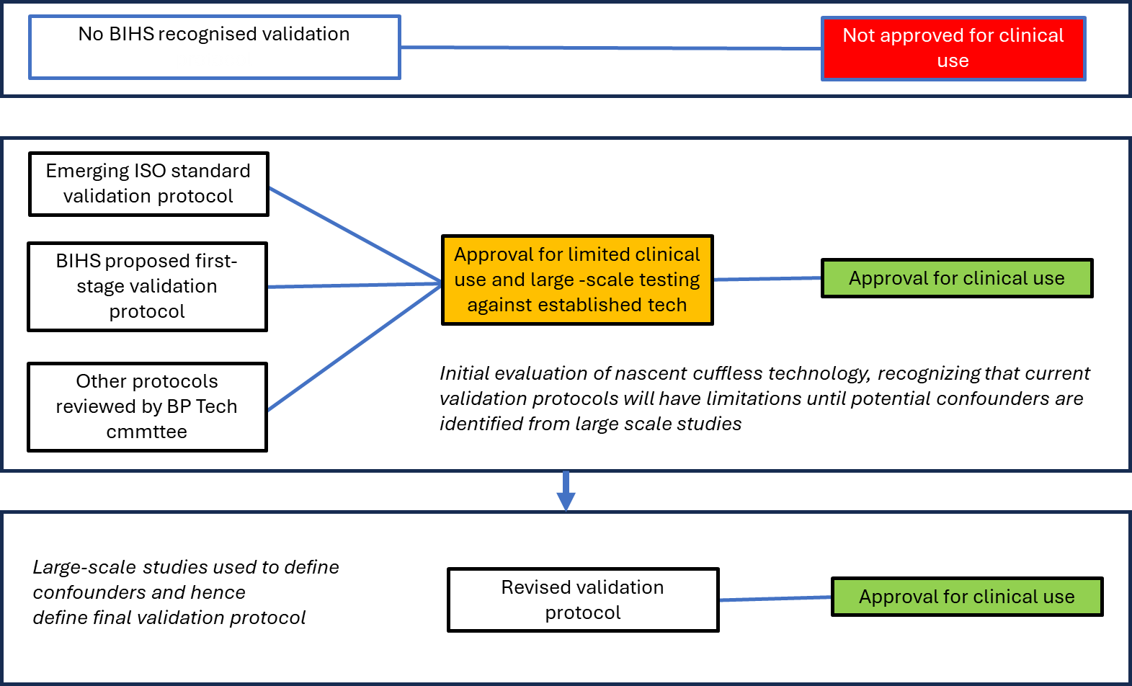
Pragmatic approach to evaluation for clinical adoption
RED
AMBER
GREEN

Slide 8
WS3: Real-world pilot development:
Designing the first reusable NHS-facing evaluation pilot for wearable BP technologies
Why Workstream 3 matters
The programme now needs a practical delivery vehicle, not just architecture
The pilot is the point at which evaluation, data pathway and clinical workflow come together
A well-designed first pilot will create both early evidence and reusable infrastructure
Without a pilot, the programme remains conceptual; with it, BIHS can move toward fundable and scalable execution

Slide 9
This is not 3 separate conversations
How the three strands connect
Each workstream informs the others; none stands alone
Workstream 1
defines the evaluation logic, use case and evidence thresholds
Workstream 2
defines what data should flow, in what form, and under what governance
Workstream 3
applies both in a real-world pilot
Pilot outcome:
A practical UK test case for wearable BP evaluation, NHS pathway fit and future scale

Slide 10
What is already clear
The first diagnostic programme use case is ABPM linked hypertension assessment, but we will look at an evaluation matric across different use cases in parallel
The first pilot is intended as a pragmatic, bounded service evaluation
The comparator is ABPM
The focus is diagnostic agreement and pathway utility, not full technical re-validation
Raw wearable outputs should not flow directly into GP records
Manufacturer evidence may inform entry, but independent scrutiny will be needed for practical clinical adoption
The pilot is intended as a reusable evaluation model, not a one-off study

Slide 11
Why ABPM is the first use case
ABPM remains the benchmark comparator for diagnostic confirmation and has the strongest current prognostic footing in this pathway discussion
It is a bounded, high-value clinical use case
It sits at a real bottleneck in practice
It allows wearable data to be tested alongside an existing pathway rather than in isolation
It helps contain medico-legal and governance risks by pairing wearable output with an established clinical process
Home BP remains highly relevant, but ABPM is being used here as the first tightly defined evaluation case.

Slide 12
Core pilot question
Can a wearable BP device support, or potentially substitute for, ABPM in a clearly bounded NHS-facing hypertension diagnosis pathway with acceptable diagnostic agreement?
Secondary practical questions
What summary outputs are useful to clinicians?
What is the minimum actionable dataset?
Can data flow into GP systems in a safe and usable way?
Do clinicians find the outputs helpful, tolerable, or burdensome?
What should remain in research/evaluation environments rather than routine clinical workflow?
Consider:
1. Qualitative user feedback (patients, GP, pharmacist, nurses)
2. Health economics evaluation

Slide 13
Phase 1 pilot: a scoped and reusable first implementation study
1. Test whether a wearable BP pathway can support hypertension assessment against ABPM in a practical NHS-facing setting
2. Generate early UK evidence on feasibility, diagnostic agreement, workflow and implementation
3. Establish a reusable model for evaluating future devices
a re-run of full technical validation science
an immediate route to blanket BIHS endorsement
a direct deployment programme for consumer wearables
a raw data dump into GP systems
a substitute for manufacturer responsibility on device evidence
an open-ended discussion exercise without defined outputs
In scope
• Pragmatic pilot of about 150-200 patients
• Comparator is gold-standard ABPM
• Focus on diagnostic agreement, not exact mmHg equivalence
• Output designed around clear decisions for hypertension support
• Intended as a reusable evaluation model for future devices and studies
This programme is not
This creates a realistic minimum utility threshold for the NHS, BIHS, sites, manufacturers and funders.
These boundaries matter because the current NHS roadmap still centres cuff-based monitoring and manual entry.
Notes:
[Sources]
- Pilot size, ABPM comparator, diagnostic-agreement framing, and simple GP-facing outputs come from the BP Wearables Team Actions and Next Steps transcript. fileciteturn0file1
- Distinction between evaluation, validation and data-flow boundaries is consistent with the BIHS programme framework. fileciteturn0file0
[/Sources]

Slide 14
First 4-6 weeks: decisions and deliverables
Parallel progress should converge into one clear programme narrative
Workstream
Immediate focus
Short term deliverable
Key meeting / dependency
Owners
1. Evaluation
Lock initial use case, decision thresholds and claims boundaries.
Draft BIHS evaluation framework and architectural statement / memo.
Review with protocol reviewers (IQVIA) and align with pilot endpoints.
Phil / James
2. Data pathway
Map device to GP practice output, what enters the record, and governance boundaries.
Target data pathway with clear clinical vs research data flows.
EHR / interoperability SME input; BHF Data Science Centre discussions.
Alun / Eduard
3. Pilot
Refine operational design for the ABPM-linked service evaluation.
Outline protocol, site assumptions, recruitment plan, and manufacturer engagement.
Site discussions; external reviewer feedback.
Manish / Phil
Parallel work: one integrated story for funding, NHS engagement, and future scale
Notes:
[Sources]
- First 4-6 week priorities and suggested outputs come from the BIHS programme framework. fileciteturn0file0
- Named roles, funding conversations, reviewer input, and recordings / webpage support come from the team transcript and action list. fileciteturn0file1
[/Sources]

Slide 15
Funding and resource requirements
What requires funding and delivery support now
Resource is needed for:
pilot setup and study delivery
site recruitment and operational coordination
data pathway design and interoperability input
independent evidence review / analysis
programme management across the three workstreams
production of reusable evaluation and implementation outputs
Funding rationale
the conceptual architecture is sufficiently developed
the next phase is execution, not further abstract scoping
funding enables delivery of a bounded pilot and the supporting evaluation infrastructure

